Slide 1
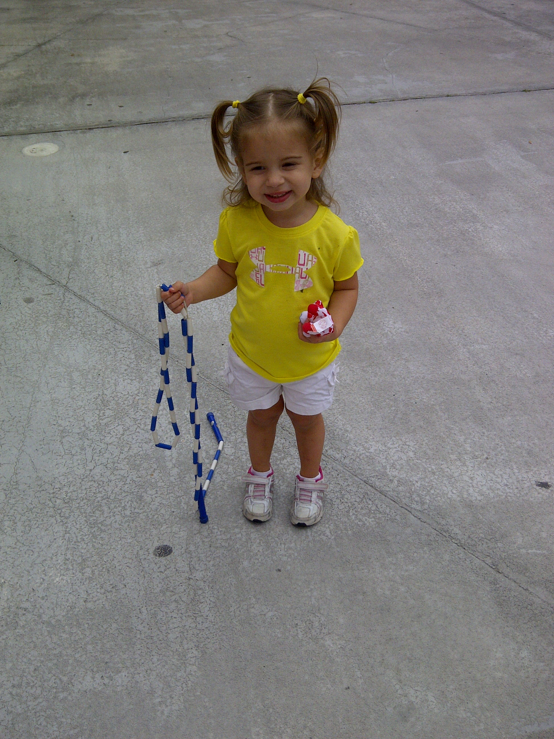
The Modern Jump Rope: The Future of Active
Video Games
AAHPERD National Convention
Charlotte, NC 2013
Lisa Witherspoon, PH.D.
Assistant Professor - University of South Florida
Director of the USF Active Gaming Research Labs
Notes:
Title

Slide 2
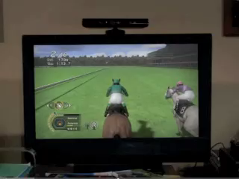
Notes:
Short video clip about technology and active gaming

Slide 3
What is Active Gaming (AG)?
Exergaming, Interactive Fitness, Technology-Driven Physical Activities
Technology Physical Activity Active Gaming
  Dance Dance Revolution, Nintendo Wii, Microsoft Kinect, Sony Move
Notes:
Active gaming is referred to exergaming, interactive fitness, technology-driven physical activities
Technology combined with physical activity where participants must move to play the game is referred to as active gaming.

Slide 4
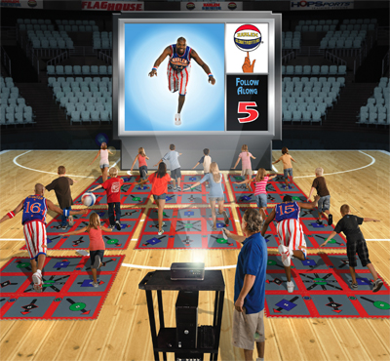
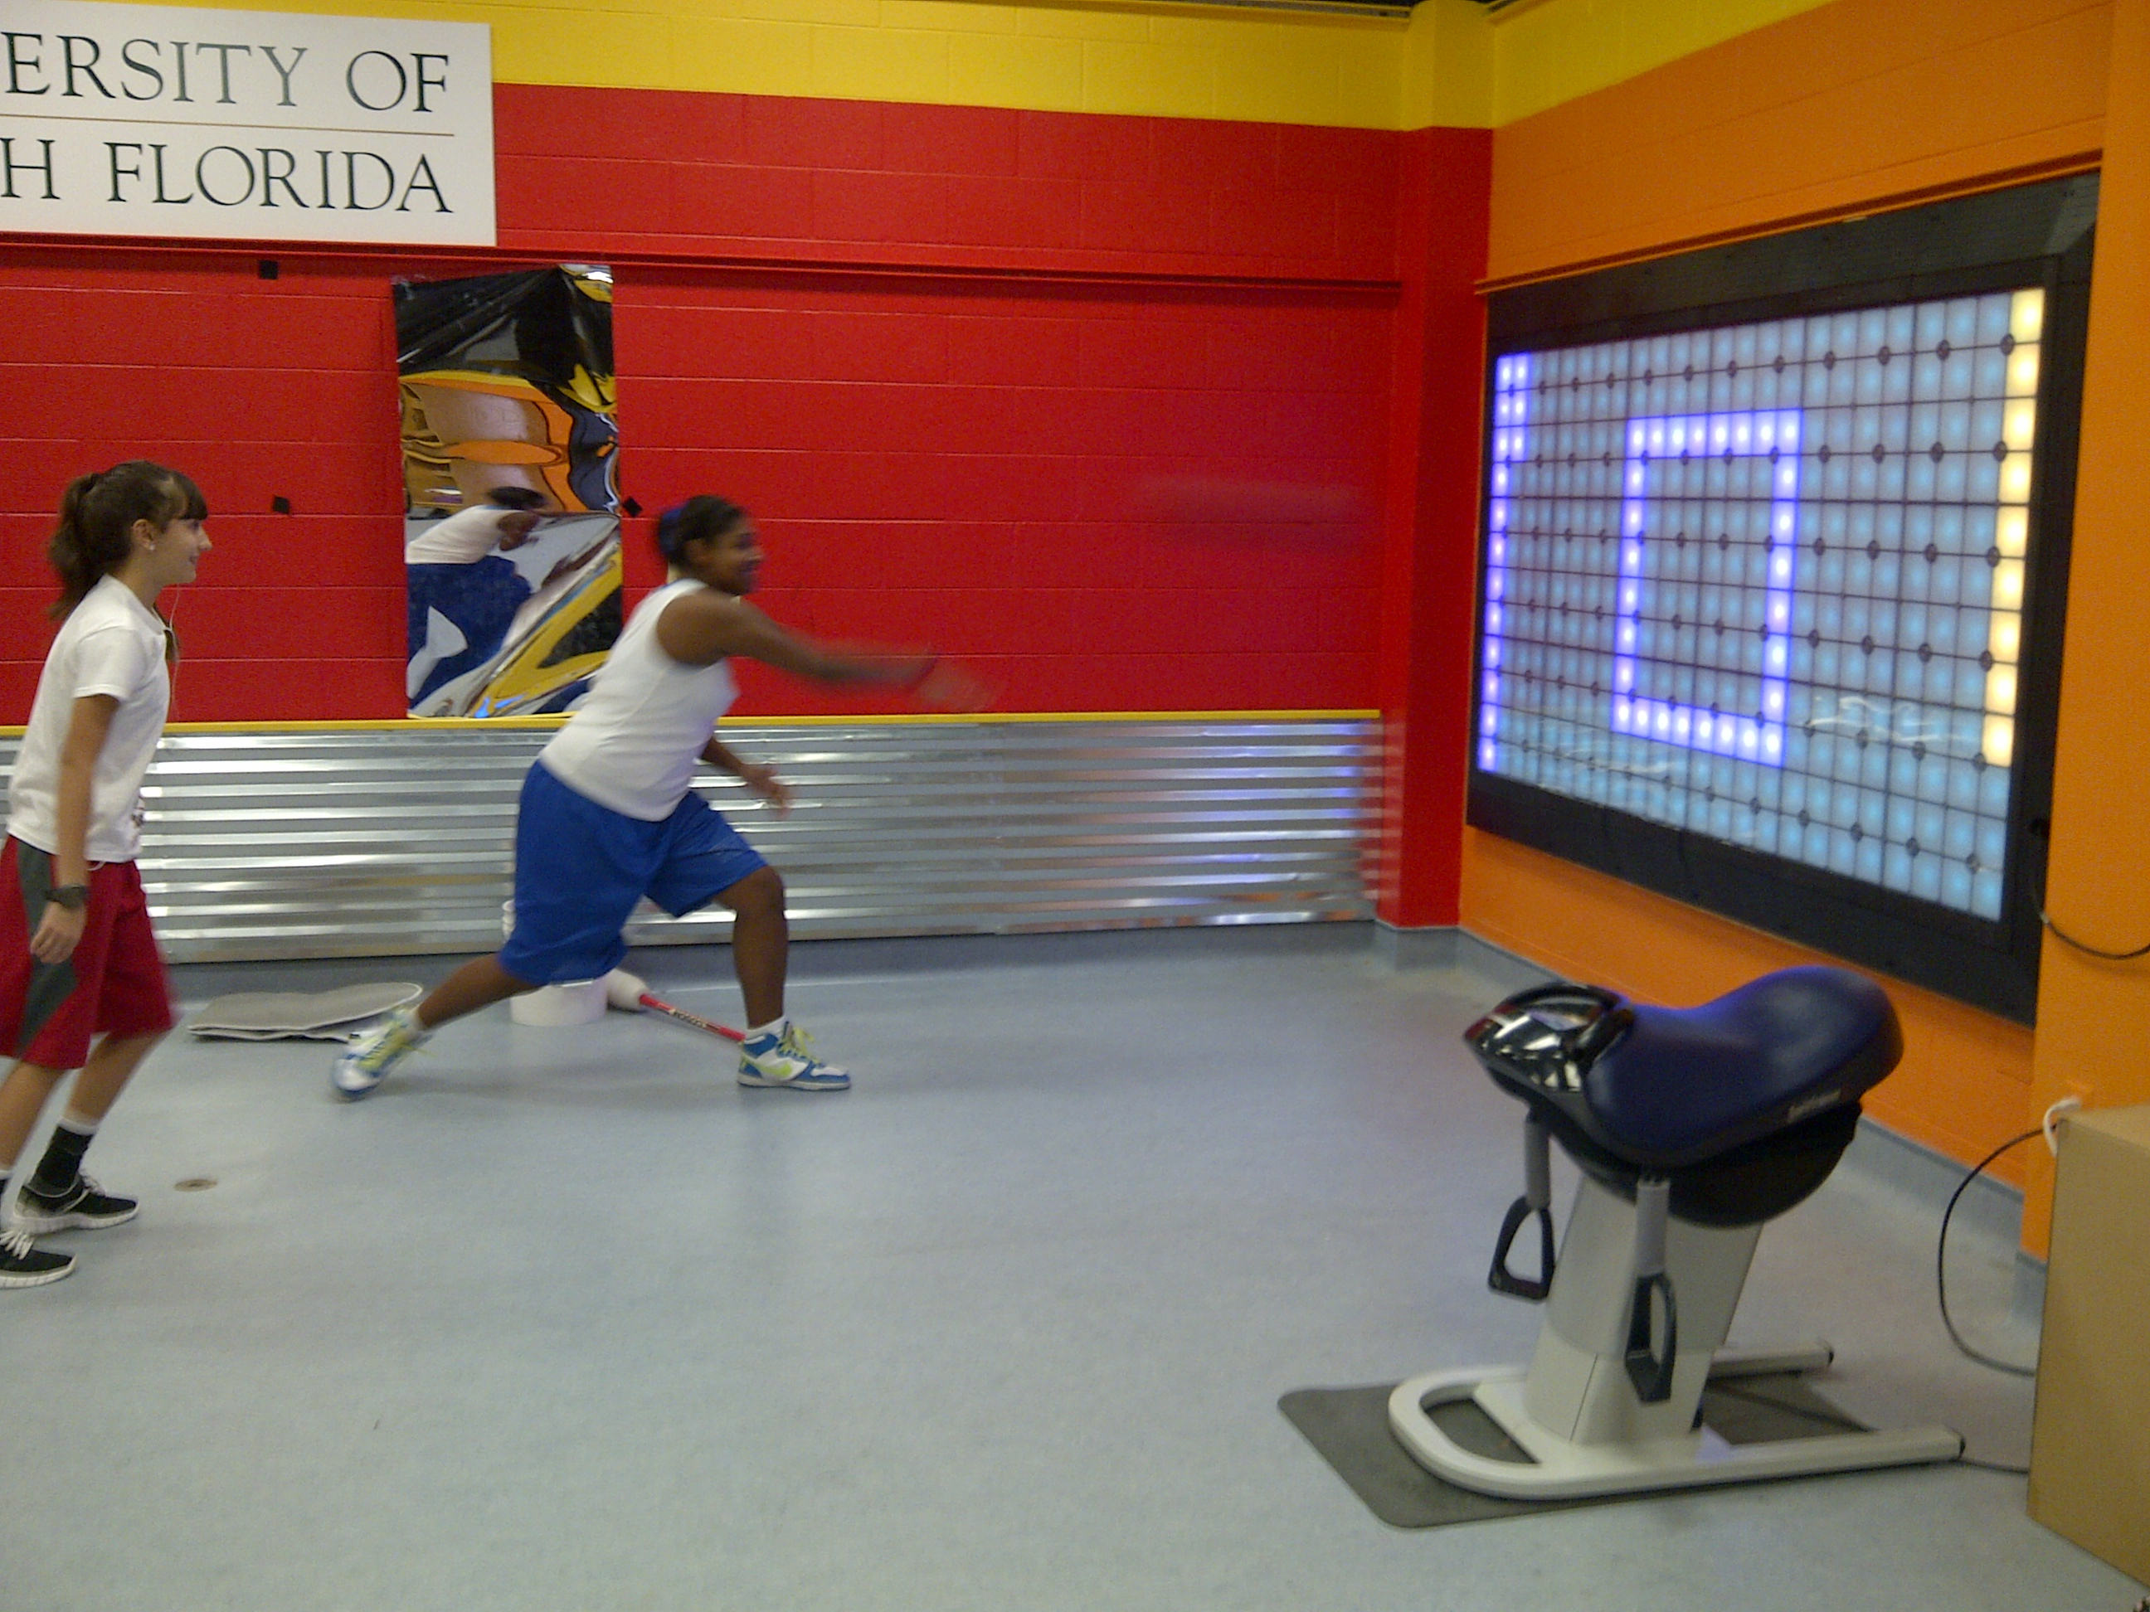
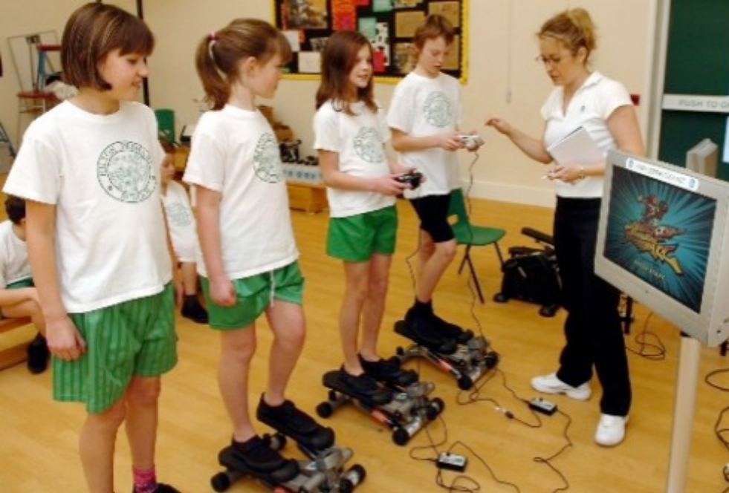
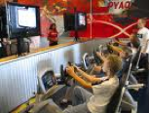
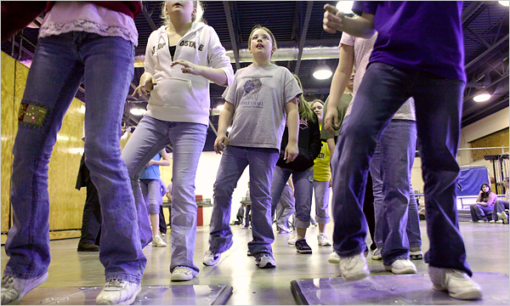
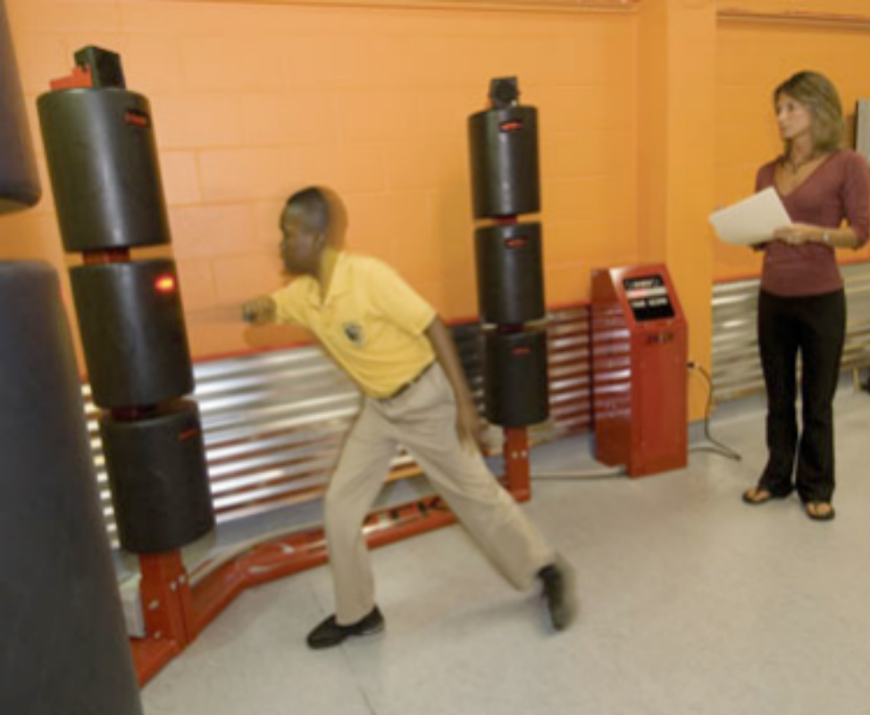
Notes:
Pictures of various active games

Slide 5
Why Active Gaming
Obesity Physical Activity
Born Mobile – Technology Saturation
Notes:
Over the past 2 decades obesity levels have increased and physical activity levels have decreased.
We need to get children more active. They are saturated in technology and desire to spend more time in front of a screen. Active gaming allows them to play the games they like through technology while being active.

Slide 6
Then and Now
Then – (5 - 7 years ago) a few health facilities and schools
Now – Doctor’s offices, corporate wellness facilities, hospitals, schools, health facilities and at HOME!
Notes:
Less then 10 years ago active gaming/exergaming did not really exist as we know it today.
Today you can find these activities everywhere…

Slide 7
AG and the DAP Challenge
AG is a tool to Accomplish Learning Objectives
  Planning Lessons around AG? Scope and Sequence?
Maximizing Participation
Providing Specific Feedback
Assessing Objectives
Notes:
Active gaming should be viewed as just another piece of equipment to accomplish learning objectives. The “modern” jump rope.
Traditional activities will often need to accompany an active game in the classroom to maximize participation.
Teachers should realize that providing specific feedback on the learning objective or cue used is important. It is easy to provide feedback related to the game itself and often tempting.
Teachers should always look to assess the learning objectives from all 3 domains.

Slide 8
A Challenge in the Physical Education Curriculum
Purpose of AG in the classroom
  Effective and is 21st Century
AG is not a babysitter
Connection to the Home – making it relevant!
Notes:
Research supports the use of active gaming in a health facility as well as a school environment. Students enjoy the modern activities which may assist many in enjoying exercise.
Active Gaming should not be used as babysitter just to have kids be “busy, happy, and good”.
There are active games for the home environment. Teachers should understand how to make active gaming in the classroom a relevant and feasible opportunity to exercise at home. Decrease sedentary screen time.

Slide 9
The Future of AG?
Technology is not going away!
Technology is becoming more appealing and desirable
Active Gaming continues to develop and improve
  Gesture Tracking
  Products developed for the Physical Education Classroom

Slide 10
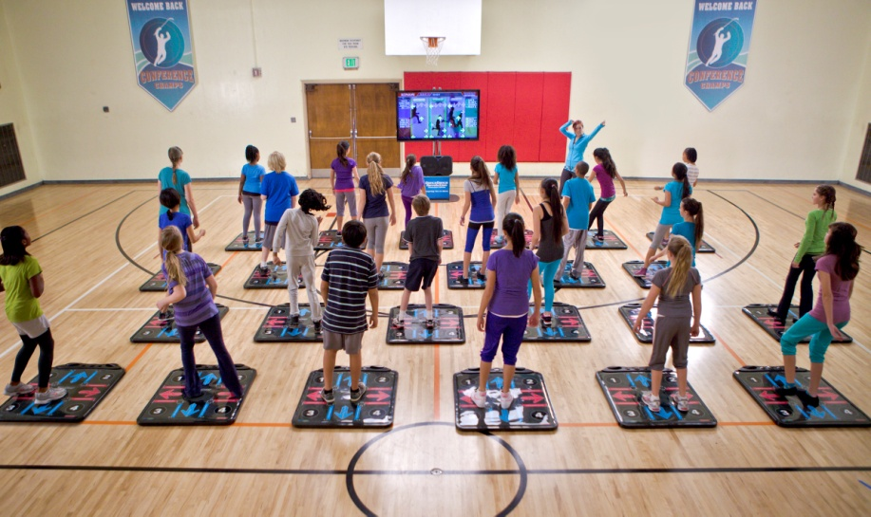
Notes:
Konami’s Dance Dance Revolution: Classroom Edition product development specifically for the physical education classroom.

Slide 11
The Future of AG in Schools
Physical Education teachers must adjust
Physical Education teachers must become aware and educated
  Why?
Professional Development – workshops, conferences, personal training, etc.

Slide 12
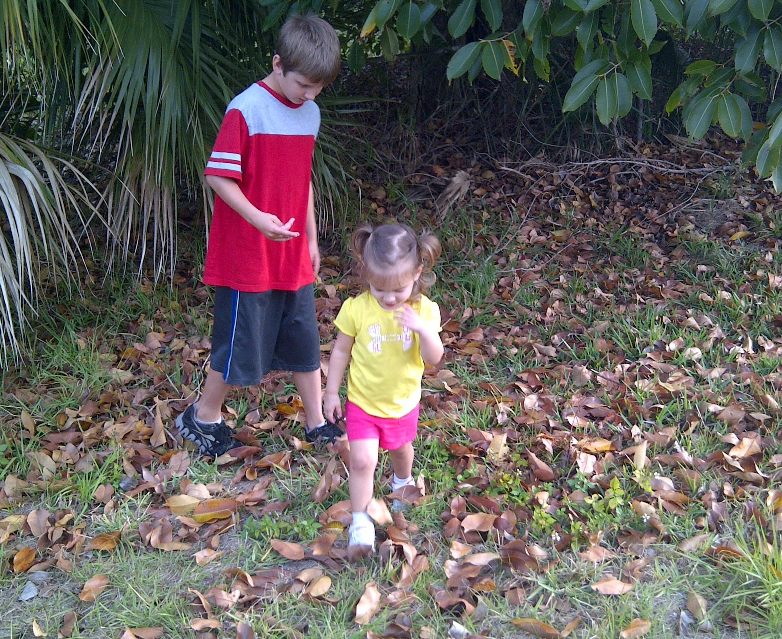

Slide 13
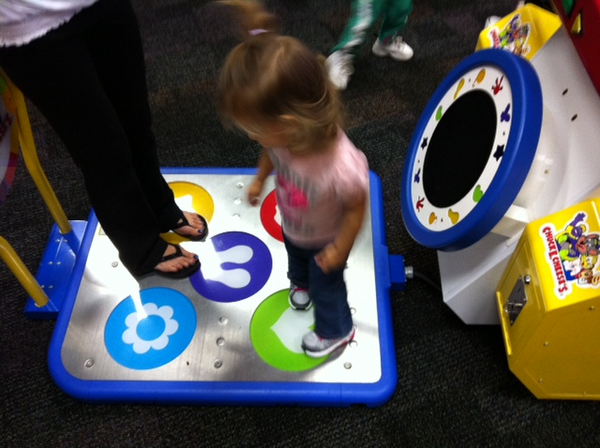
Notes:
A dance dance revolution version at Chuck e Cheese.

Slide 14
Thank You ☺
Lisa Witherspoon Ph.D. withersp@usf.edu
Assistant Professor, School of Physical Education and Exercise Science
Director of the University of South Florida Active Gaming Research Labs
Notes:
Contact information

